Slide 1
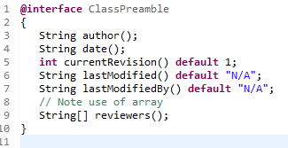
Declaring an Annotation Type
To add this same metadata with an annotation, We must first define the annotation type.
The annotation type definition looks similar to an interface definition where the keyword interface is preceded by the at sign (@) (@ = AT, as in annotation type).
The body of the annotation definition contains annotation type element declarations, which look a lot like methods. Note that they can define optional default values.
Suppose that a software group traditionally starts the body of every class with comments providing important information
public class MyClass
{
// Author: Ram
// Date: 3/17/2017
// Current revision: 2
// Last modified: 4/12/2012
// Last modified by: Peter
// Reviewers: Alice, Bill, Cindy
// class code goes here
}
metadata

Slide 2
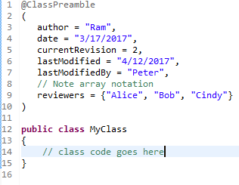
Declaring an Annotation Type
After the annotation type is defined, we can use annotations of that type, with the values filled in, like this
public class MyClass
{
// Author: Ram
// Date: 3/17/2017
// Current revision: 2
// Last modified: 4/12/2012
// Last modified by: Peter
// Reviewers: Alice, Bill, Cindy
// class code goes here
}
metadata

Slide 3
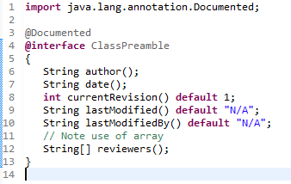
Declaring an Annotation Type
To make the information in @ClassPreamble appear in Javadoc-generated documentation, you must annotate the @ClassPreamble definition with the @Documented annotation.

